Slide 1
INTER PROCESS COMMUNICATION & DATA-BUS
~Sanu roy (25HS10009)

Slide 2
WHAT IS IPC ?
Inter Process Communication (IPC) is a mechanism that allows different processes (programs) running on a system to :
Communicate with each other
Exchange data
Coordinate their actions
SIMPLE INTUITION:
Let person A is in IIT Kharagpur and person B is in IIT Bombay. They want to start a start up. How will they communicate?
The solution is to use a mobile phone
The same way two different processes in operating systems communicate each other with help of IPC, where IPC plays the role of mobile phone as in the previous example

Slide 3
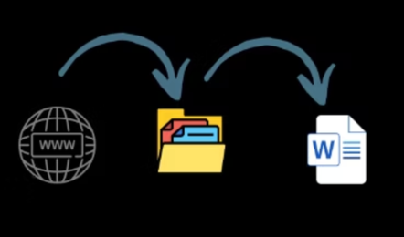
Main problem without IPC and the solutions:
For every process our system creates different execution context and different virtual address space. And hence it becomes impossible for different process to communicate and share data.
But in reality,
System is not isolated e.g. if we download a file from chrome then it gets saved and if we open it by Microsoft Word it gets opened.
For the first process, file explorer needed to get the data with chrome and in the second process, file explorer must share data with Microsoft Word.
This is where the IPC plays its role. By different methods, it enables the system to share data between different processes and let them communicate.

Slide 4



Inter process communication Models:
There are 3 types of IPC models which are further divided into sub categories–
Shared Memory Model
Message Passing Model
High-Level IPC Systems and D-bus

Slide 5
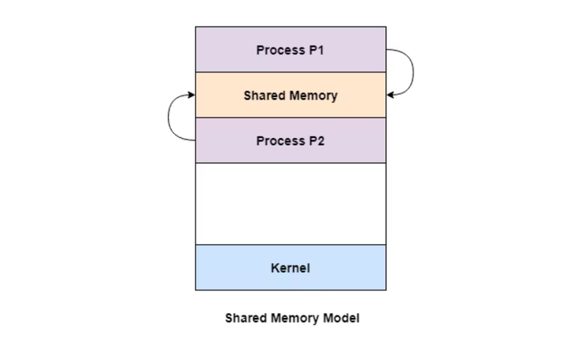
SHARED MEMORY MODEL
some part of memory is allocated for two process
Both processes must agree for sharing memory
To get the shared memory, there must be buffer items that one process (producer) can produce and another process (consumer) can consume.
BUFFER
UNBOUNDED BUFFER
BOUNDED BUFFER
NO SIZE LIMIT
PRODUCER CAN PRODUCE AS MUCH AS IT WANT
CONSUMER MAY HAVE TO WAIT IF NOTHING IS PRODUCED
PRODUCER ARE NOT SINCE IT CAN PRODUCE AS MUCH AS IT WANTS
SIZE LIMIT IS THERE
PRODUCER MAY HAVE TO WAIT UNTIL CONSUMER CONSUMES
CONSUMERS ARE ALSO SUPPOSE TO WAIT WHEN THERE IS NOTHING PRODUCED

Slide 6
SHARED MEMORY MODEL & SYNCHRONIZED MECHANISM :
What if one same data is needed to be passed to multiple processes?
Synchronization mechanisms are used to control the order of execution.
The answer is Synchronized mechanism.
WORKING PRINCIPLE:
Semaphores: These use a counter to manage access. If the resource is available, the process enters; otherwise, it waits. They are flexible and can allow multiple processes depending on the counter value.
Mutex Locks: These are simpler and stricter. A mutex allows only one process at a time. If a process locks it, others must wait until it is released. This ensures mutual exclusion.
Monitors: These are high-level constructs that automatically handle synchronization. They combine shared data and the procedures that operate on it, ensuring safe access without manual locking.

Slide 7
SHARED MEMORY MODEL → SHARED MODEL & SYNCHRONIZED MECHANISM :
If not designed properly, it can lead to:
Deadlock: Two or more processes wait forever for each other to release resources.
Starvation: A process never gets access because others keep taking priority.
Despite these challenges, synchronization is critical in real-world systems like operating systems, databases, and multi-threaded applications.
It ensures:
Correct program execution
Data integrity
Efficient use of shared resources
In simple terms, synchronization is what makes shared memory safe and usable in concurrent systems.

Slide 8
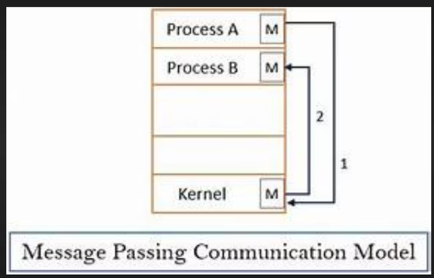
MESSAGE PASSING MODEL:
Processes communicate by sending and receiving messages instead of sharing memory.
Communication happens through the operating system,
Ensures modular and safer
Basic Working Principle
In message passing, communication happens using two fundamental operations:
Send: A process sends a message to another process.
Receive: A process receives a message from another process.
The operating system acts as an intermediary, ensuring that messages are delivered correctly. This avoids direct interaction between processes and reduces the risk of data corruption.
well-defined protocol: both sender and receiver must agree on message format and timing.

Slide 9
MESSAGE PASSING MODEL:
Types of Communication (Direct vs Indirect)
Direct Communication:
The sender explicitly names the receiver (e.g., send(P2, message), receive(P1, message)). This creates a direct link between processes.
Establishes between two processes only.
Indirect Communication:
Messages are sent to a mailbox or port instead of directly to a process. Any process with access to that mailbox can receive the message.
There can be multiple users linked with the same mailbox
Only one can receive at a time but receive operation can be called in any order (the priority is set by Round Robin Algorithm)
It uses 4 processes:
pipes
sockets
signals
messge quese

Slide 10
Message passing model:
Buffering and Message Queues
Messages are often stored temporarily in buffers or queues managed by the OS.
There are three types:
Zero Capacity: No buffering; sender must wait until receiver is ready.
Bounded Capacity: Limited buffer size; sender waits if buffer is full.
Unbounded Capacity: Unlimited buffer; sender never waits.
Real-World Examples
Distributed Systems: Communication over networks using protocols.
Microservices Architecture: Services communicate via APIs or message queues.
Operating Systems: Some OS designs (like microkernels) rely heavily on message passing.
Technologies like pipes, sockets, and message queues are practical implementations of this model

Slide 11
Message passing model:
Disadvantages of Message Passing
Despite its advantages, message passing has some drawbacks:
Slower Communication: Involves system calls and copying of data, which adds overhead.
Complex Protocol Design: Processes must agree on message formats and timing.
Latency Issues: Delays may occur due to buffering and scheduling.
Compared to shared memory, message passing is generally less efficient but more secure.

Slide 12
IPC IN UNIX
Unix keeps every process isolated, hence the same problem as discussed previously reises and hence Ipc is needed.
Types of IPC in UNIX
Shared Memory
Named Pipes (FIFOs)
Each mechanism differs in:
Speed
Complexity
Scope (related vs unrelated processes)

Slide 13
IPC METHODS IN UNIX SHARED MEMORY
The concept of Shared Memory in unix is same as previously discussed but it is more low level in this case In UNIX/Linux, shared memory is not automatic—you must create and manage it manually using system calls like:
shmget() -> create shared memory
shmat() -> attach memory to process
shmdt() -> detach
shmctl() -> control/delete
The OS ensures that only authorized processes can access the shared memory
So it's safe but controlled
Shared memory does NOT provide synchronization
You must explicitly use:
Semaphores
Mutex
Same as theory, but in UNIX must be implemented explicitly

Slide 14
IPC METHODS IN UNIX MESSAGE PASSING
Message passing in unix work by 3 processes
Pipe
Sockets
Message queues

Slide 15
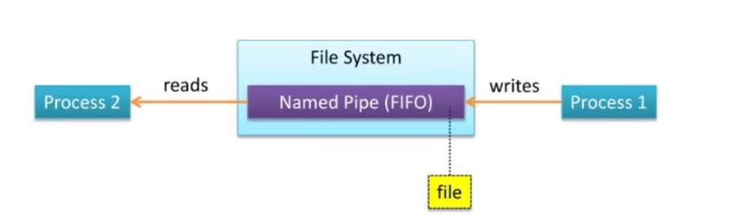
Message Passing Named Pipes:
Named pipes overcome the limitation of unnamed pipes by allowing communication between unrelated processes.
They exist as special files in the file system, meaning any process with permission can access them.
Unlike unnamed pipes:
They persist even after processes terminate
They allow communication without a parent-child relationship
They are still FIFO-based and unidirectional.

Slide 16
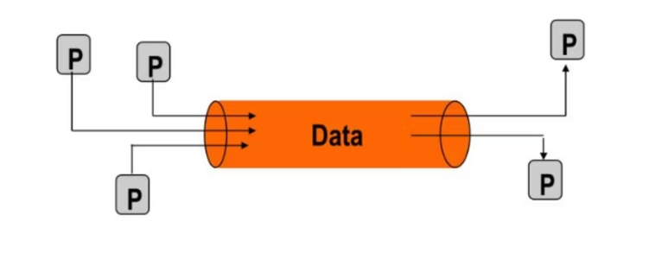
Message Passing Unnamed Pipes:
Pipes are the simplest IPC mechanism in UNIX.
Allows communication between related processes (like parent and child). A pipe is created using a system call and provides a unidirectional communication channel.
One process writes data into the pipe, and another reads from it. The data flows in a first-in, first-out (FIFO) manner.
However, unnamed pipes have limitations:
Only work between related processes
One-way communication

Slide 17
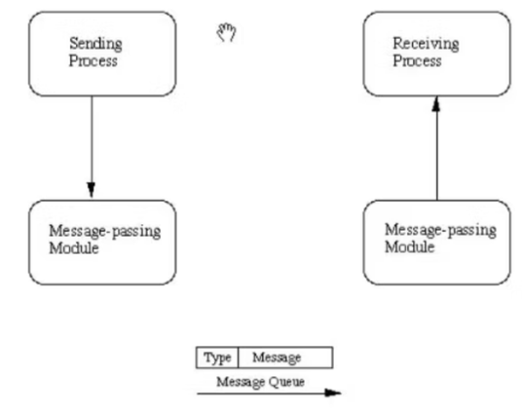
MESSAGE PASSING MESSAGE QUEUES
Message queues allow processes to exchange messages in a structured and asynchronous manner.
Instead of a continuous stream of data (like pipes), messages are sent as discrete units.
Each message can have:
A type
A priority
The OS manages the queue and ensures messages are delivered properly. This allows more flexible communication than pipes.

Slide 18
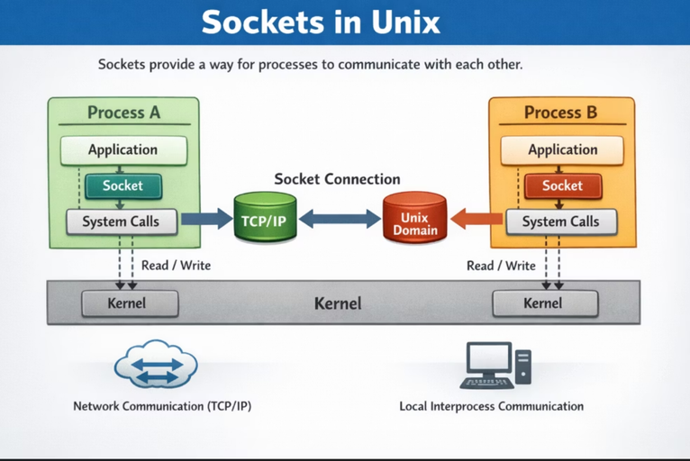
MESSAGE PASSING SOCKETS
There are 3 parts of the whole process
1. Server Side
Create socket → socket()
Bind to address → bind()
Listen for connections → listen()
Accept connection → accept()
2. Client Side
Create socket → socket()
Connect to server → connect()
3. Communication
Send data → send() / write()
Receive data → recv() / read()

Slide 19
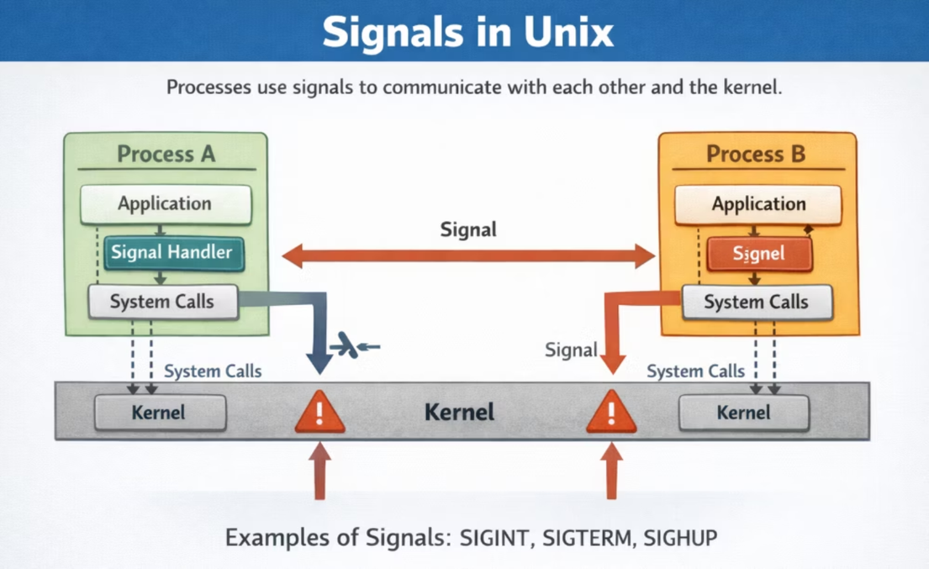
Signals
Signals in Unix are a lightweight IPC (Inter-Process Communication) mechanism used to notify a process that some event has occurred. A signal does not carry data; it only informs a process that an event has occurred.
How Signals Work :
A signal is generated (by OS, user, or another process)
The signal is sent to a target process
The process handles the signal in one of three ways:

Slide 20
Semaphores (Synchronization)
Semaphores are used to control access to shared resources.
They work using a counter:
If resource is available → process proceeds
If not → process waits
Semaphores ensure:
Mutual exclusion
Proper ordering of execution
They are often used with shared memory to prevent race conditions.

Slide 21

IPC IN LINUX:
Linux provides a rich and flexible set of IPC mechanisms that allow processes to communicate, synchronize, and share data efficiently.
Unlike basic UNIX, Linux supports both:
System V IPC (traditional)
POSIX IPC (modern, standardized)
This dual support makes Linux highly versatile—it can run legacy applications while also supporting modern, scalable systems.
Linux IPC is used everywhere—from simple shell commands to complex distributed systems and servers.

Slide 22
SYSTEM V IPC (TRADITIONAL MECHANISMS)
System V IPC is the older IPC system, still widely used.
It includes:
Message Queues
Shared Memory
Semaphores
These mechanisms use keys to identify resources, meaning processes must agree on a key to communicate.
While powerful, System V IPC can be:
Harder to manage
Less intuitive
But it gives fine-grained control, which is useful in low-level programming

Slide 23
POSIX IPC (MODERN APPROACH)
POSIX IPC was introduced to make IPC:
Easier to use
More portable
More consistent
It includes:
POSIX message queues
POSIX shared memory
POSIX semaphores
Unlike System V:
Uses file-like naming (e.g., /myqueue)
Integrates better with modern APIs

Slide 24
PIPES IN LINUX (VERY IMPORTANT)
Pipe in linux is same as pipe in unix
But linux provides more :
Linux has more optimized kernel buffer handling
Linux integrates pipes deeply with the shell environment
Linux supports:
Non-blocking pipes
Advanced file descriptor control (fcntl)
Pipe Buffer Size
Linux allows tuning buffer size (in some cases)
Traditional UNIX systems were more limited

Slide 25
Named Pipes in Linux:
Named pipe in linux is same as pipe in unix except:
How They Work Internally
Even though they look like files:
Data is not written to disk
It goes into a kernel buffer
One process writes → another reads
File system is just used for naming and access control
Advantages of Named Pipes
Works between unrelated processes
Simple to use (file-based)
No need for shared memory
Automatic synchronization

Slide 26
POSIX MESSAGE QUEUES IN LINUX:
The POSIX message queues, which are more modern and easier to use.
file-like naming (e.g., /queue1) : instead of key-based identification, making queue management simpler and more intuitive.
Better support for message priorities : higher-priority messages to be processed before others, which is useful in real-time systems.
Non-blocking and asynchronous operations: Improved performance by allowing processes to continue execution without waiting.
Has a more optimized kernel implementation : Faster message handling and better scalability for multiple processes.
Better integration with modern applications and systems.

Slide 27
SYNCHRONISATION IN LINUX:
Extra Synchronization Features in Linux
Linux extends traditional UNIX synchronization by providing more advanced and efficient mechanisms. While UNIX mainly used System V semaphores, Linux adds several modern tools.
Linux introduces mutex locks, which are simpler and faster than semaphores for ensuring that only one process or thread accesses a critical section at a time. It also provides condition variables, which allow processes to wait for specific conditions instead of continuously checking, improving CPU efficiency.
Another improvement is POSIX semaphores, which are easier to use and more flexible compared to older System V semaphores. Linux also supports read-write locks, allowing multiple processes to read data simultaneously while restricting write access to one process, improving performance.
Additionally, Linux uses futexes (fast user-space mutexes), which reduce kernel involvement and increase speed. It also supports thread-level synchronization (pthreads), enabling efficient synchronization in multi-threaded programs.

Slide 28
EXTRA SYNCHRONIZATION FEATURES IN LINUX
Linux extends traditional UNIX synchronization by providing more advanced and efficient mechanisms. While UNIX mainly used System V semaphores, Linux adds several modern tools.
Linux introduces mutex locks, which are simpler and faster than semaphores for ensuring that only one process or thread accesses a critical section at a time. It also provides condition variables, which allow processes to wait for specific conditions instead of continuously checking, improving CPU efficiency.
Another improvement is POSIX semaphores, which are easier to use and more flexible compared to older System V semaphores. Linux also supports read-write locks, allowing multiple processes to read data simultaneously while restricting write access to one process, improving performance.
Additionally, Linux uses futexes (fast user-space mutexes), which reduce kernel involvement and increase speed. It also supports thread-level synchronization (pthreads), enabling efficient synchronization in multi-threaded programs.

Slide 29
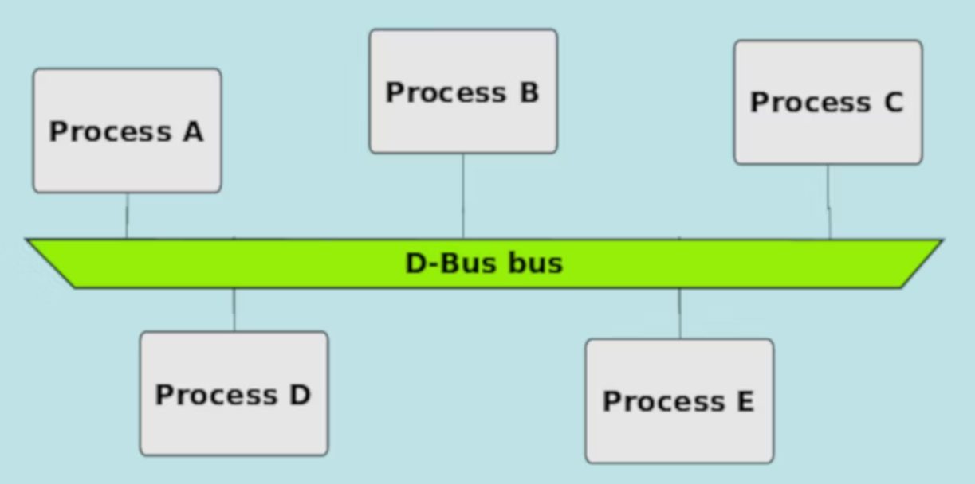
WHAT IS D-BUS?
D-Bus (Desktop Bus) is a message-based IPC system used in Linux and other Unix-like systems.
It allows processes (called services) to communicate with each other by sending messages in a structured way.
Unlike low-level IPC (pipes, shared memory), D-Bus provides a high-level, organized communication system.
It is widely used in desktop environments (like GNOME, KDE) and system services.
D-Bus follows a client-server model, where applications request services and receive responses.

Slide 30
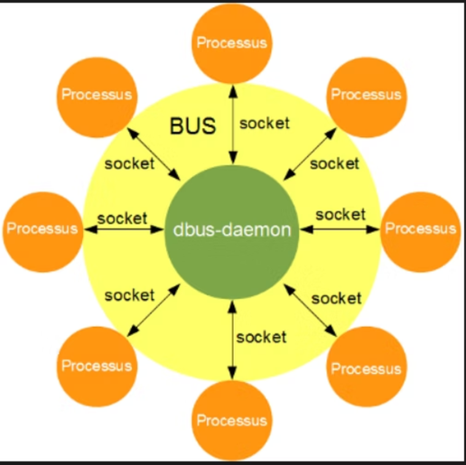
WORKING PRINCIPLE OF DBUS:
Communication in D-Bus happens through structured messages, not shared memory or raw data streams. This means processes exchange clearly defined information (like method calls or signals), making communication more organized and easier to manage.
Instead of sending messages directly to each other, processes communicate through a central message bus (broker). When a process wants to interact with another:
It sends a message to the D-Bus daemon (bus)
The bus then routes the message to the correct destination process
This removes the need for processes to know each other's internal details.
Processes in D-Bus can perform three main types of communication:
Method Calls (Request-Response) A process sends a request asking another process to perform some action (e.g., "open a file" or "get system status").
Replies (Responses) The receiving process processes the request and sends back a result or confirmation.
Signals (Event Broadcasting) A process can send a signal that is broadcast to multiple listeners, such as notifying that a device was connected or a setting changed.

Slide 31
Features Provided by D-Bus :
High-Level IPC Mechanism : Allows processes to communicate using structured messages rather than raw data.
Centralized Bus Architecture: D-Bus uses a central message bus (daemon) that handles communication between processes i.e. processes do not need to directly connect with each other—the bus manages routing.
Asynchronous Communication Support: Allows processes to send messages without waiting for a response improving performance and responsiveness.
Message-Based Communication: All communication in D-Bus happens through well-defined messages such as method calls, replies, and signals ensuring organized, consistent data exchange.

Slide 32
Features Provided by D-Bus:
Security and Access Control: Includes built-in security mechanisms to ensure only authorized processes can communicate.
Service-Oriented Communication: Follows a service-based model where applications expose functionalities as services.
Event Broadcasting (Signals): D-Bus allows a process to send signals that can be received by multiple processes simultaneously. This is useful for system-wide notifications like hardware changes or system events.

Slide 33
Architecture of D-bus:
There are 3 layers in the architecture:
Layer 1: D-bus Protocol
This is the lowest level of the stack. It isn't code, but a specification.
Binary Stream: Unlike text-based protocols (JSON/XML), D-Bus uses a binary wire format. This allows for extremely fast marshaling and unmarshaling.
Type System: It defines a strict type system (strings, integers, Booleans, arrays, and dictionaries) so that a C++ application and a Python application can understand the data being exchanged without ambiguity.
Message Types: It defines four primary packets: Method Calls, Method Returns, Signals (broadcasts), and Errors.
Layer 2: C library( libdbus):
Abstraction: It provides the low-level API to open a connection to the bus, buffer messages, and handle the authentication handshake (usually via SASL).
dbus-python. These wrappers make D-Bus calls look like native function calls in that language.

Slide 34
Architecture of D-bus:
3. Layer 3: D-bus daemon:
This is the "brain" or the Message Broker.
Routing: When Process A wants to talk to Process B, it doesn't connect to Process B directly. It sends a message to the Daemon. The Daemon looks at the "address" (the Bus Name) and routes the message to the correct recipient.
Lifecycle Management: The daemon can "auto-start" services. If you try to talk to a service that isn't running, the daemon can launch it on demand.
Security Policies: The daemon enforces XML-based security policies that define which users or processes are allowed to send specific messages.
The Logic Hierarchy(Addressing)
To make this architecture functional, D-Bus uses a filesystem-like hierarchy to find specific code inside an application:
Bus Name: The "Address" of the application (e.g., org.freedesktop.NetworkManager).
Object Path: The "Instance" inside the app (e.g., /org/freedesktop/NetworkManager/Devices/0).
Interface: The "Category" of functions (e.g., org.freedesktop.NetworkManager.Device).
Member: The specific Method (function) or Signal (event) being triggered.

Slide 35
ARCHITECTURE OF D-BUS:
System vs. Session: The Two Buses
A key part of the architecture is that it usually runs two separate instances of the daemon:
The System Bus: One per computer. Used for hardware events, system updates, and low-level kernel communication.
The Session Bus: One per user login. Used for desktop-level tasks like volume control, notifications, and clipboard sharing.

Slide 36
THANK YOU

